Slide 1


ASSIGNMENT 2
COP290
GAME DEV
BY PRATYAKSH
& PRIYANSHU

Slide 2


THE KEY
ELEMENTS
01
GAME CONCEPT
02
DESIGN CHOICES
03
HIGHLIGHTS
04
FUTURE IMPROVEMENTS
05
CONCLUSION

Slide 3

CRIME RATE HAS BEEN RISE TO 445.9 PER 100000 PEOPLE
TOI

Slide 4
WHAT IS
OUR GAME IDEA?
Crime and lawlessness plague our cities, spiraling out of control. In this chaos emerges a silent guardian - a ninja warrior dedicated to restoring order and justice.
Our game lets you become this enigmatic ninja protagonist. Armed with lethal skills, your mission is to confront criminal elements head-on through intense combat and navigation challenges.

Slide 5
02
DESIGN CHOICES
Game Structure: Multiple levels with increasing difficulty, each containing a set number of enemies to defeat.
Level Objectives: The primary goal in each level is for the ninja protagonist to eliminate all enemies through combat to progress.
Level Design: Strategic placement of enemies, obstacles, and cover.
Character Design:
Ninja Protagonist: Agile warrior with martial arts skills and ninja weaponry
Enemy Types: Multiple enemy trying to attack ninja

Slide 6

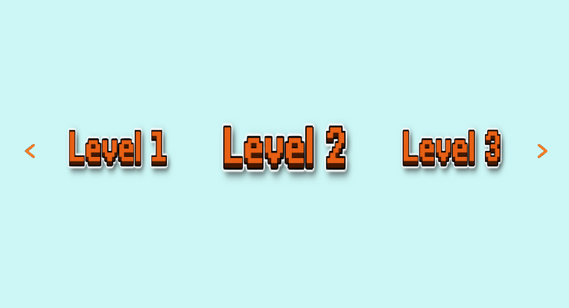
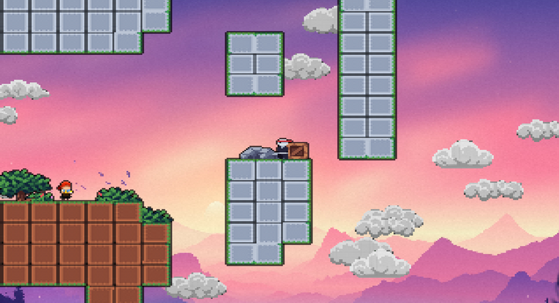
DESIGN HIGHLIGHTS
03
Parallax Effect
Hover effect

Slide 7
IMPLEMENTATION
HIGHLIGHT
Different scripts like entities, level, tilemap are written in different file
All the images are loaded layer by layer in which the farthest layer is loaded first.
Only objects that are currently showing on screen are loaded no other object is loaded that time
Random movement of various objects like enemy attack, cloud movement
Creating editor to easily make new levels

Slide 8
THE ROLE OF
THANKS
A LOT
PRATYAKSH 2022CS51654
PRIYANSHU 2022CS51649

